Slide 1

GitHub Today: 2/5/2020
https://github.com/
Daniel Woodard

Slide 2

What we will explore today !
GitHub
Repository
Branching
Collaborators
GitHub Desktop
Ect…
Integration
Git Large File Storage (LFS)
Connection between GitHub and Android Studio?
Random !

Slide 3
GitHub
https://guides.github.com/activities/hello-world/
WHAT IS GITHUB ?!?!
GitHub is a platform dedicated to allowing people to work together build code.
Allowing users to host their code for all to see and use / edit / and to comment upon. ( Depending on settings)
Teams of people can build together and collab together to keep up with versions and merge their code.

Slide 4



GitHub
WHAT IS REPOSITORY ?!?!
Repository – In simple terms is a folder created by a group of people to store files in that all that have access can view.
The repository can hold files / photos / data sets / videos.
Ect…

Slide 5

GitHub
WHAT IS BRANCHING ?!?!
By default the first branch or the first created version of your submits are considered the master branch. This is the main version that people will want to use and edit.
However, you can create different branches off from the master for experimentation or to test different kinds of solutions / features before applying changes to the master branch.

Slide 6


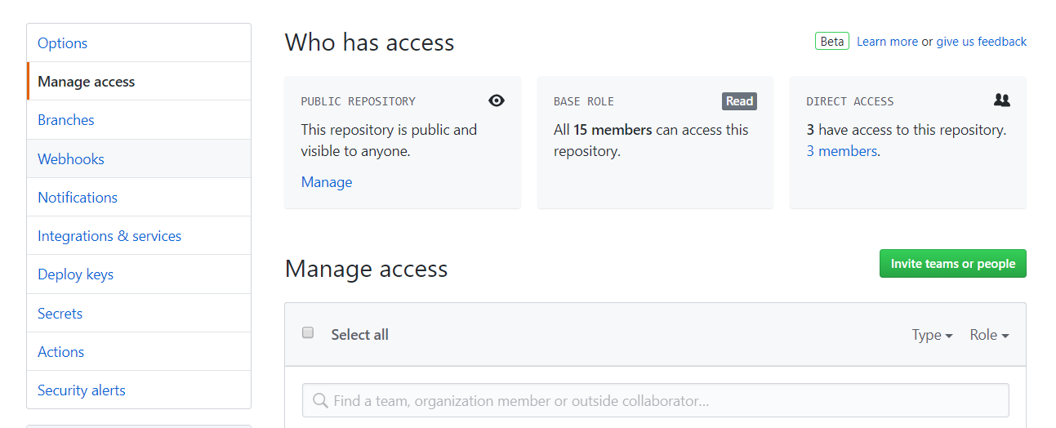

GitHub
WHAT IS COLLABORATORS ?!?!
Collaborators are the team members chosen to help build your project !
What do you mean you can’t see the code?
Was ever member added to the group?

Slide 7


GitHub
WHAT IS COMMITS ?!?!
We got the team, the repository, and we know what branches are now!
Now committing is the next step, in which, you will upload your code into the repository so that your team members can view and edit.

Slide 8
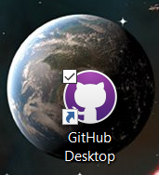
GitHub - PAUSE
https://desktop.github.com/
WHAT IS GITHUB DESKTOP ?!?!
PAUSE – Sadly, GitHub does not like huge files being deposited in one shot!
(That would include our type of projects)
Here I recommend GitHub Desktop… It can be helpful in uploading your larger files however, it is not needed.
I will go forward as if we are going through GitHub Desktop.
This is not the only method possible, another way will be explored a bit later.

Slide 9
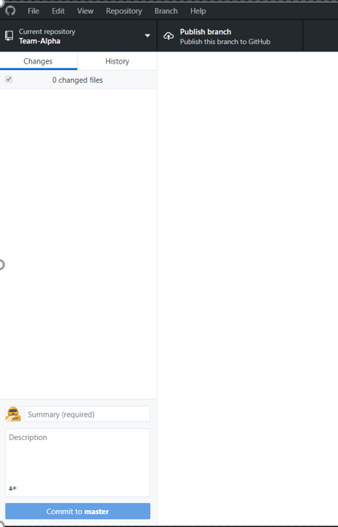
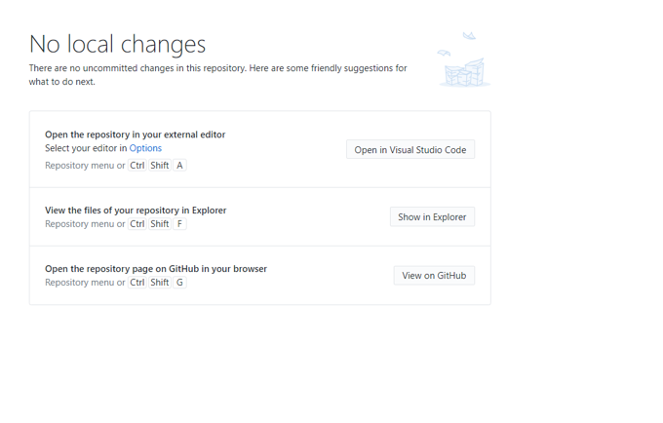
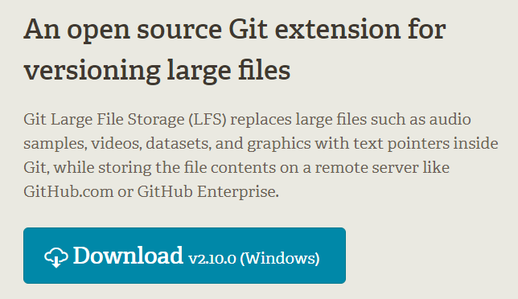

Integration
https://git-lfs.github.com/
WHAT IS GIT LARGE FILE STORAGE (LFS) ?!?!
Git large file storage allows one to upload your files bit by bit via a command prompt after a bit of setup (NOT HARD).
Pros – Simple, very good online tutorial. See above link…
Cons – More downloads – yes, there seems to always be more.

Slide 10
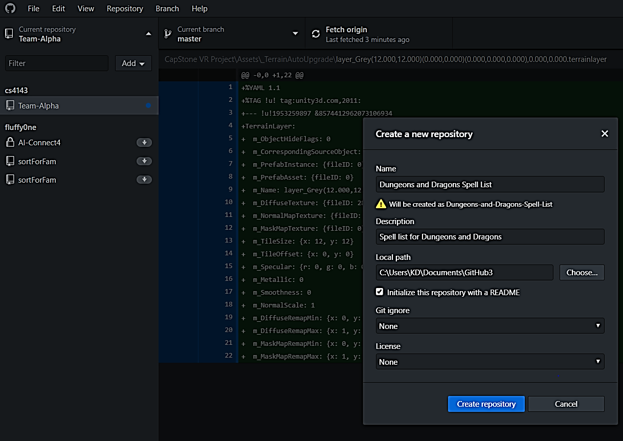
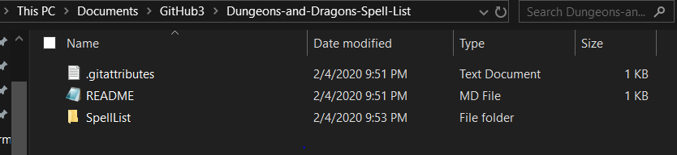
Integration
Making Repository via GitHub Desktop !!!
Make the repository inside of GitHub Desktop.
You can use the Add button to simply do this.
Next move your current files to the created folder.
Yes dark mode

Slide 11




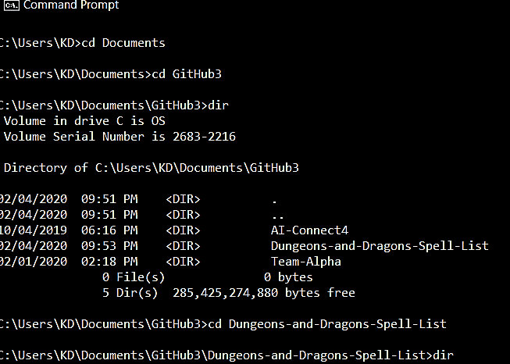
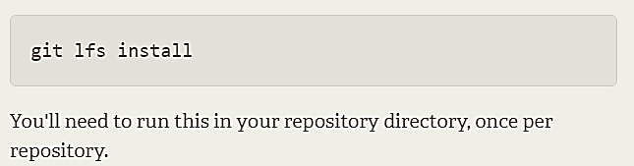
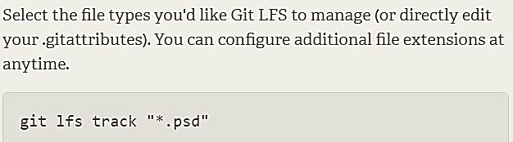

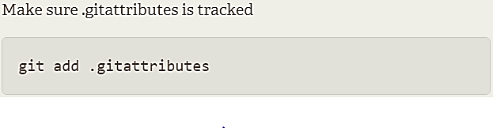

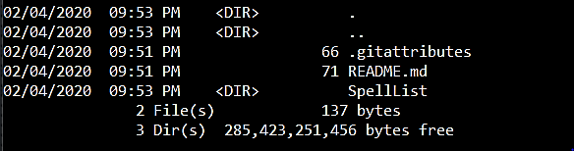
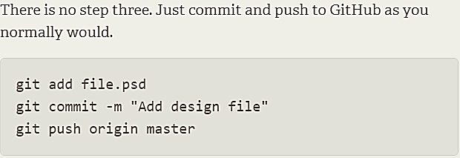
https://git-lfs.github.com/
These three, are last
First
Second
Lastly! (Check top)

Slide 12
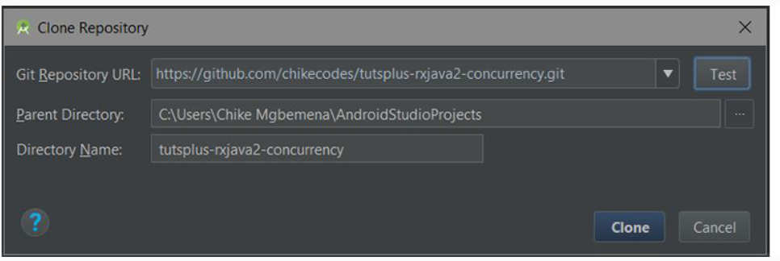
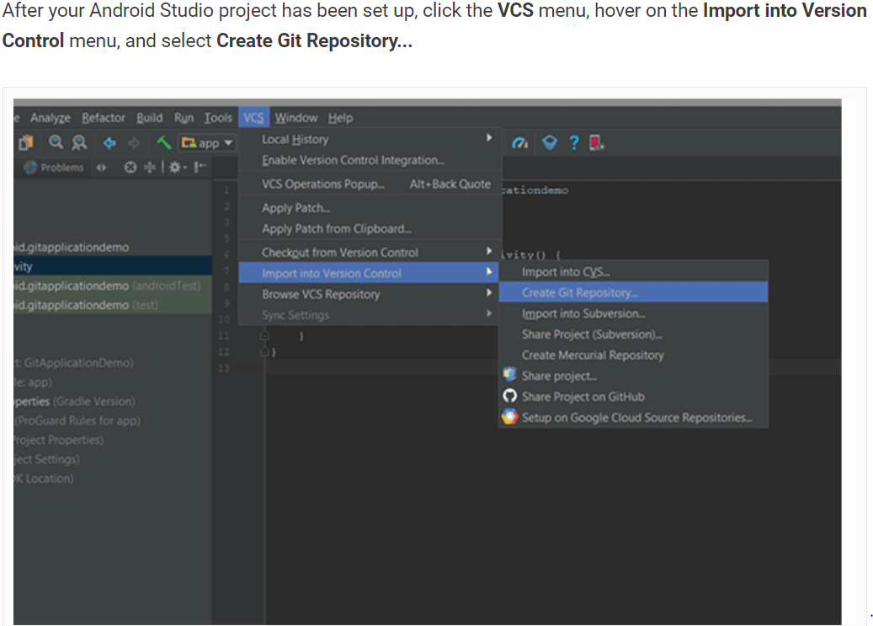
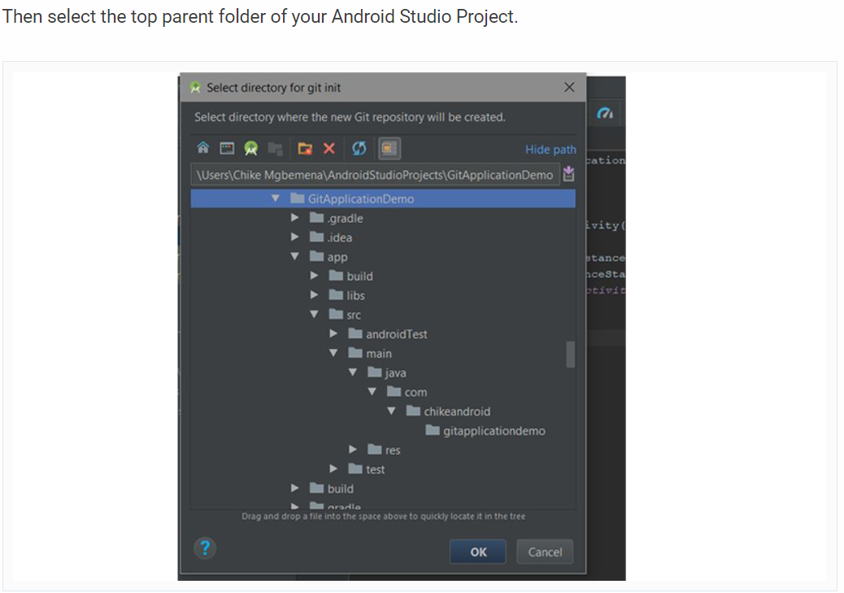
Connection between GitHub and Android Studio?
IS IT POSSIBLE ?!?!
Yes, yes it is.
Branching / pushing / committing / Ect….
https://code.tutsplus.com/tutorials/working-with-git-in-android-studio--cms-30514

Slide 13

Random !
QUESTIONS!?!?

Slide 14

DONE

